Slide 1
Using Nomad for Multi-platform job deployment and management
Rob Jackson
Sr. Solutions Engineer

Slide 2
Agenda
About the Sock Shop demo
Origins/Applications/Usages
Current Setup
Deployment Structure
Tools Used
Communications
Nomad Focus
Usages and Applications for Nomad

Slide 3
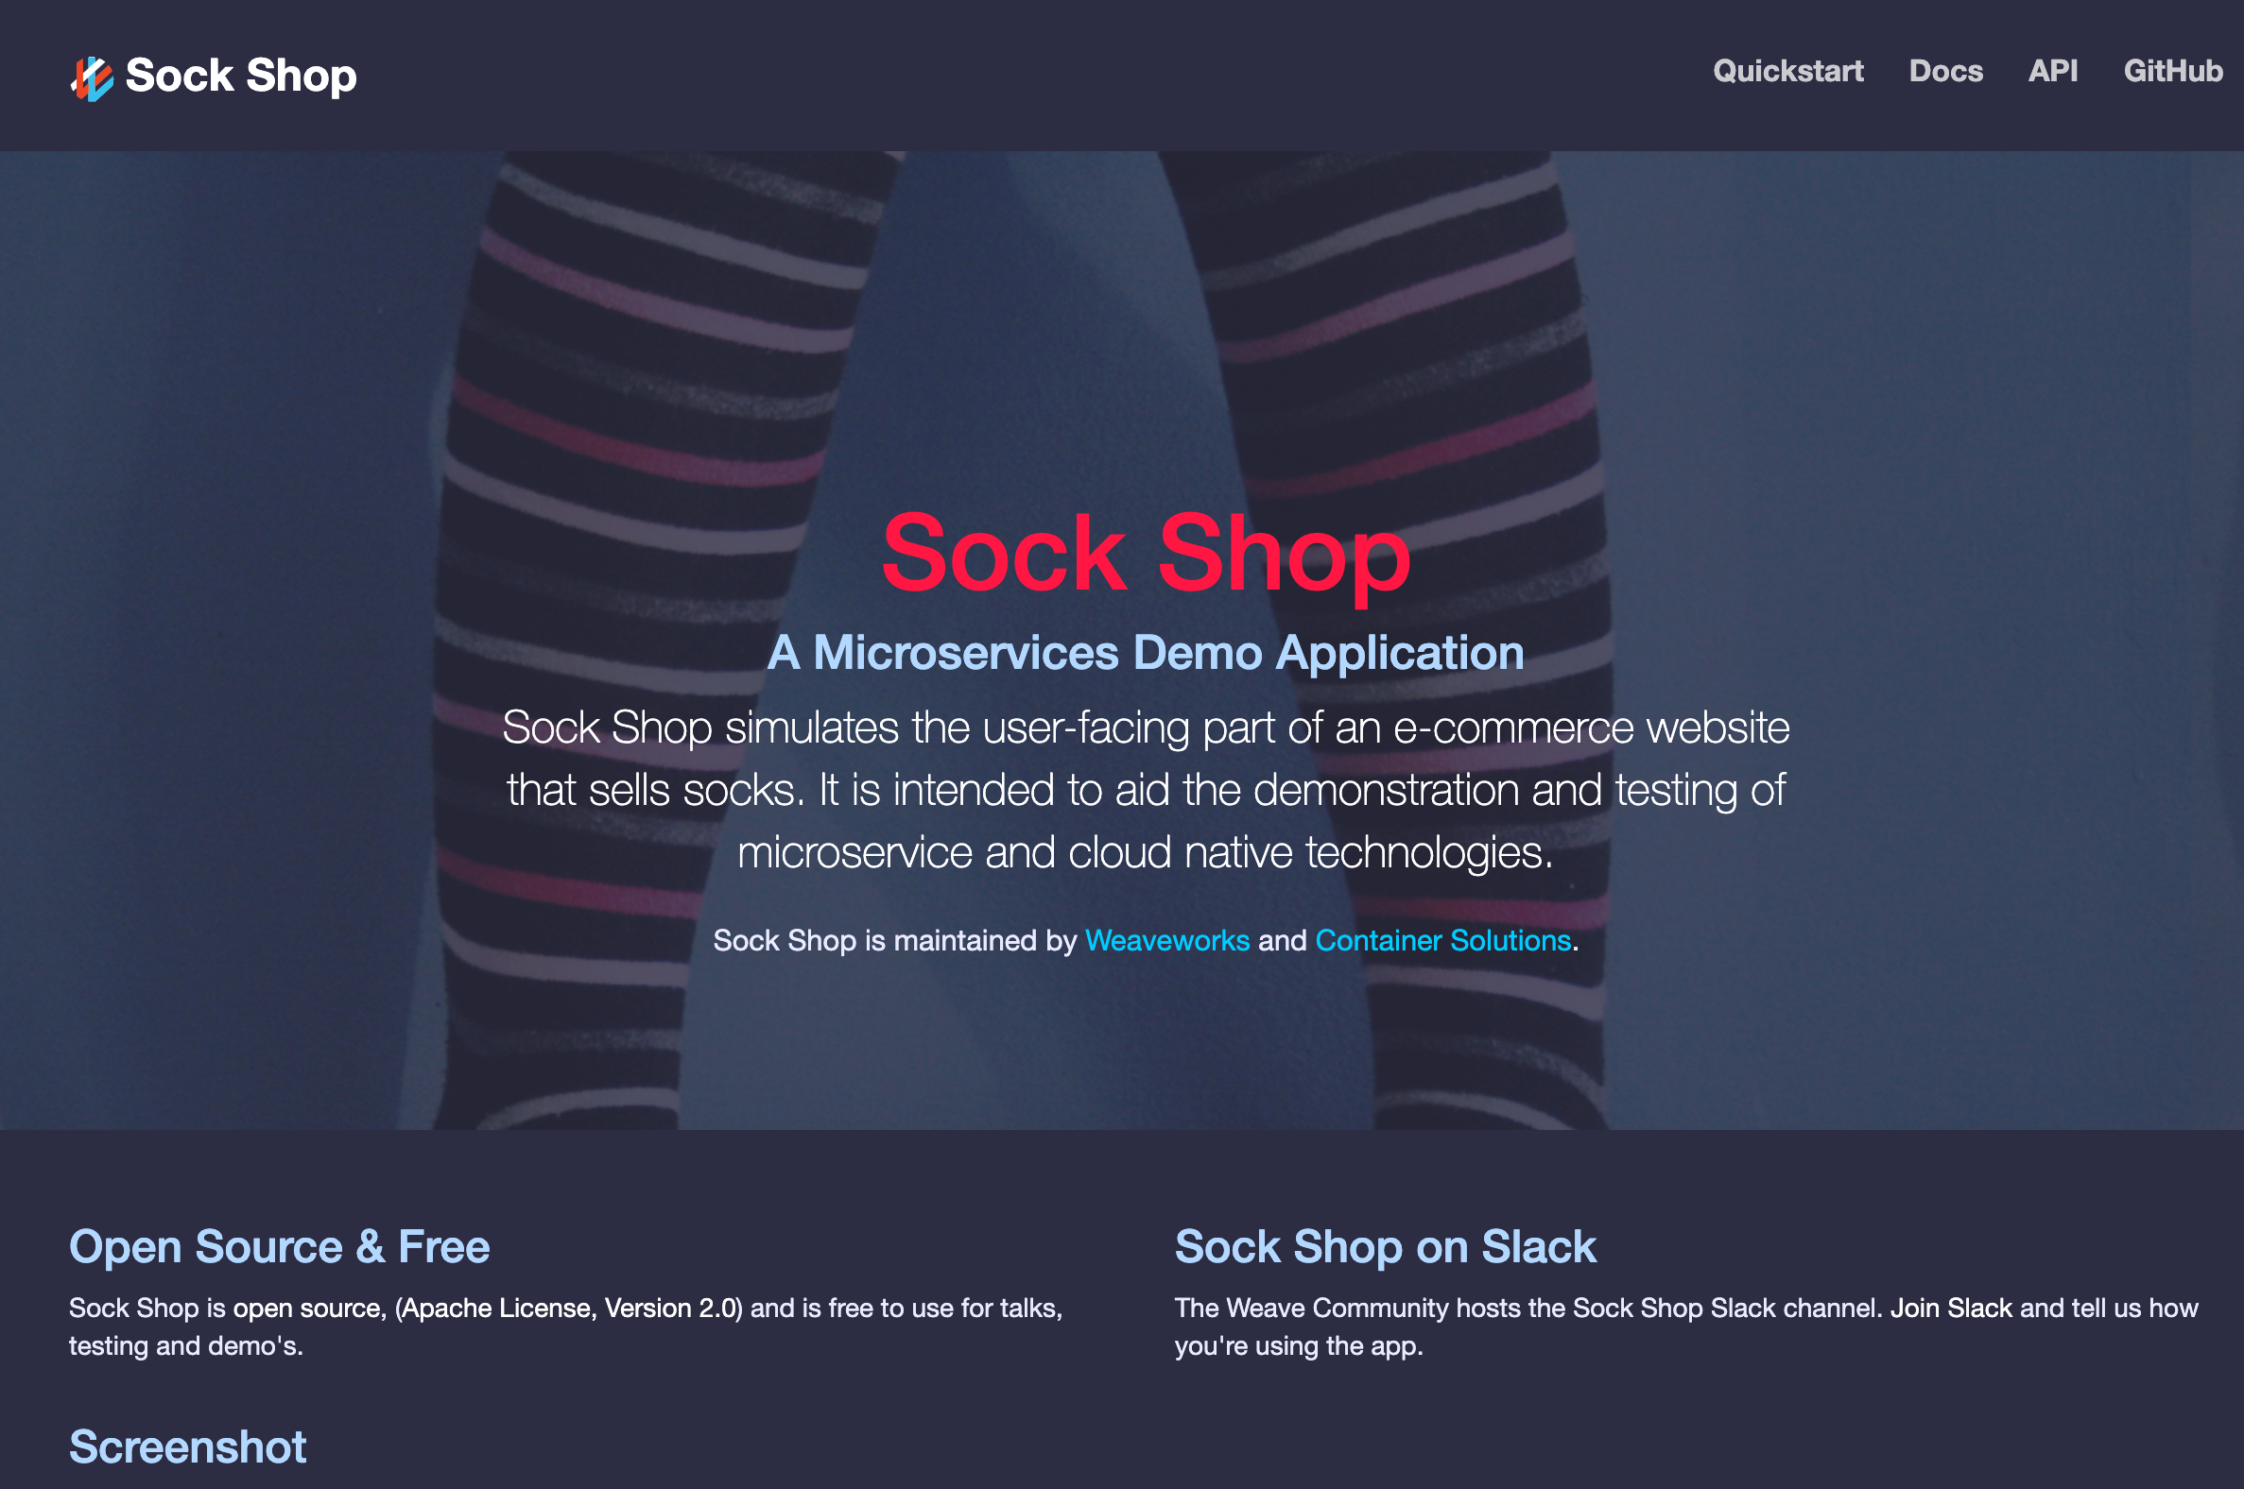
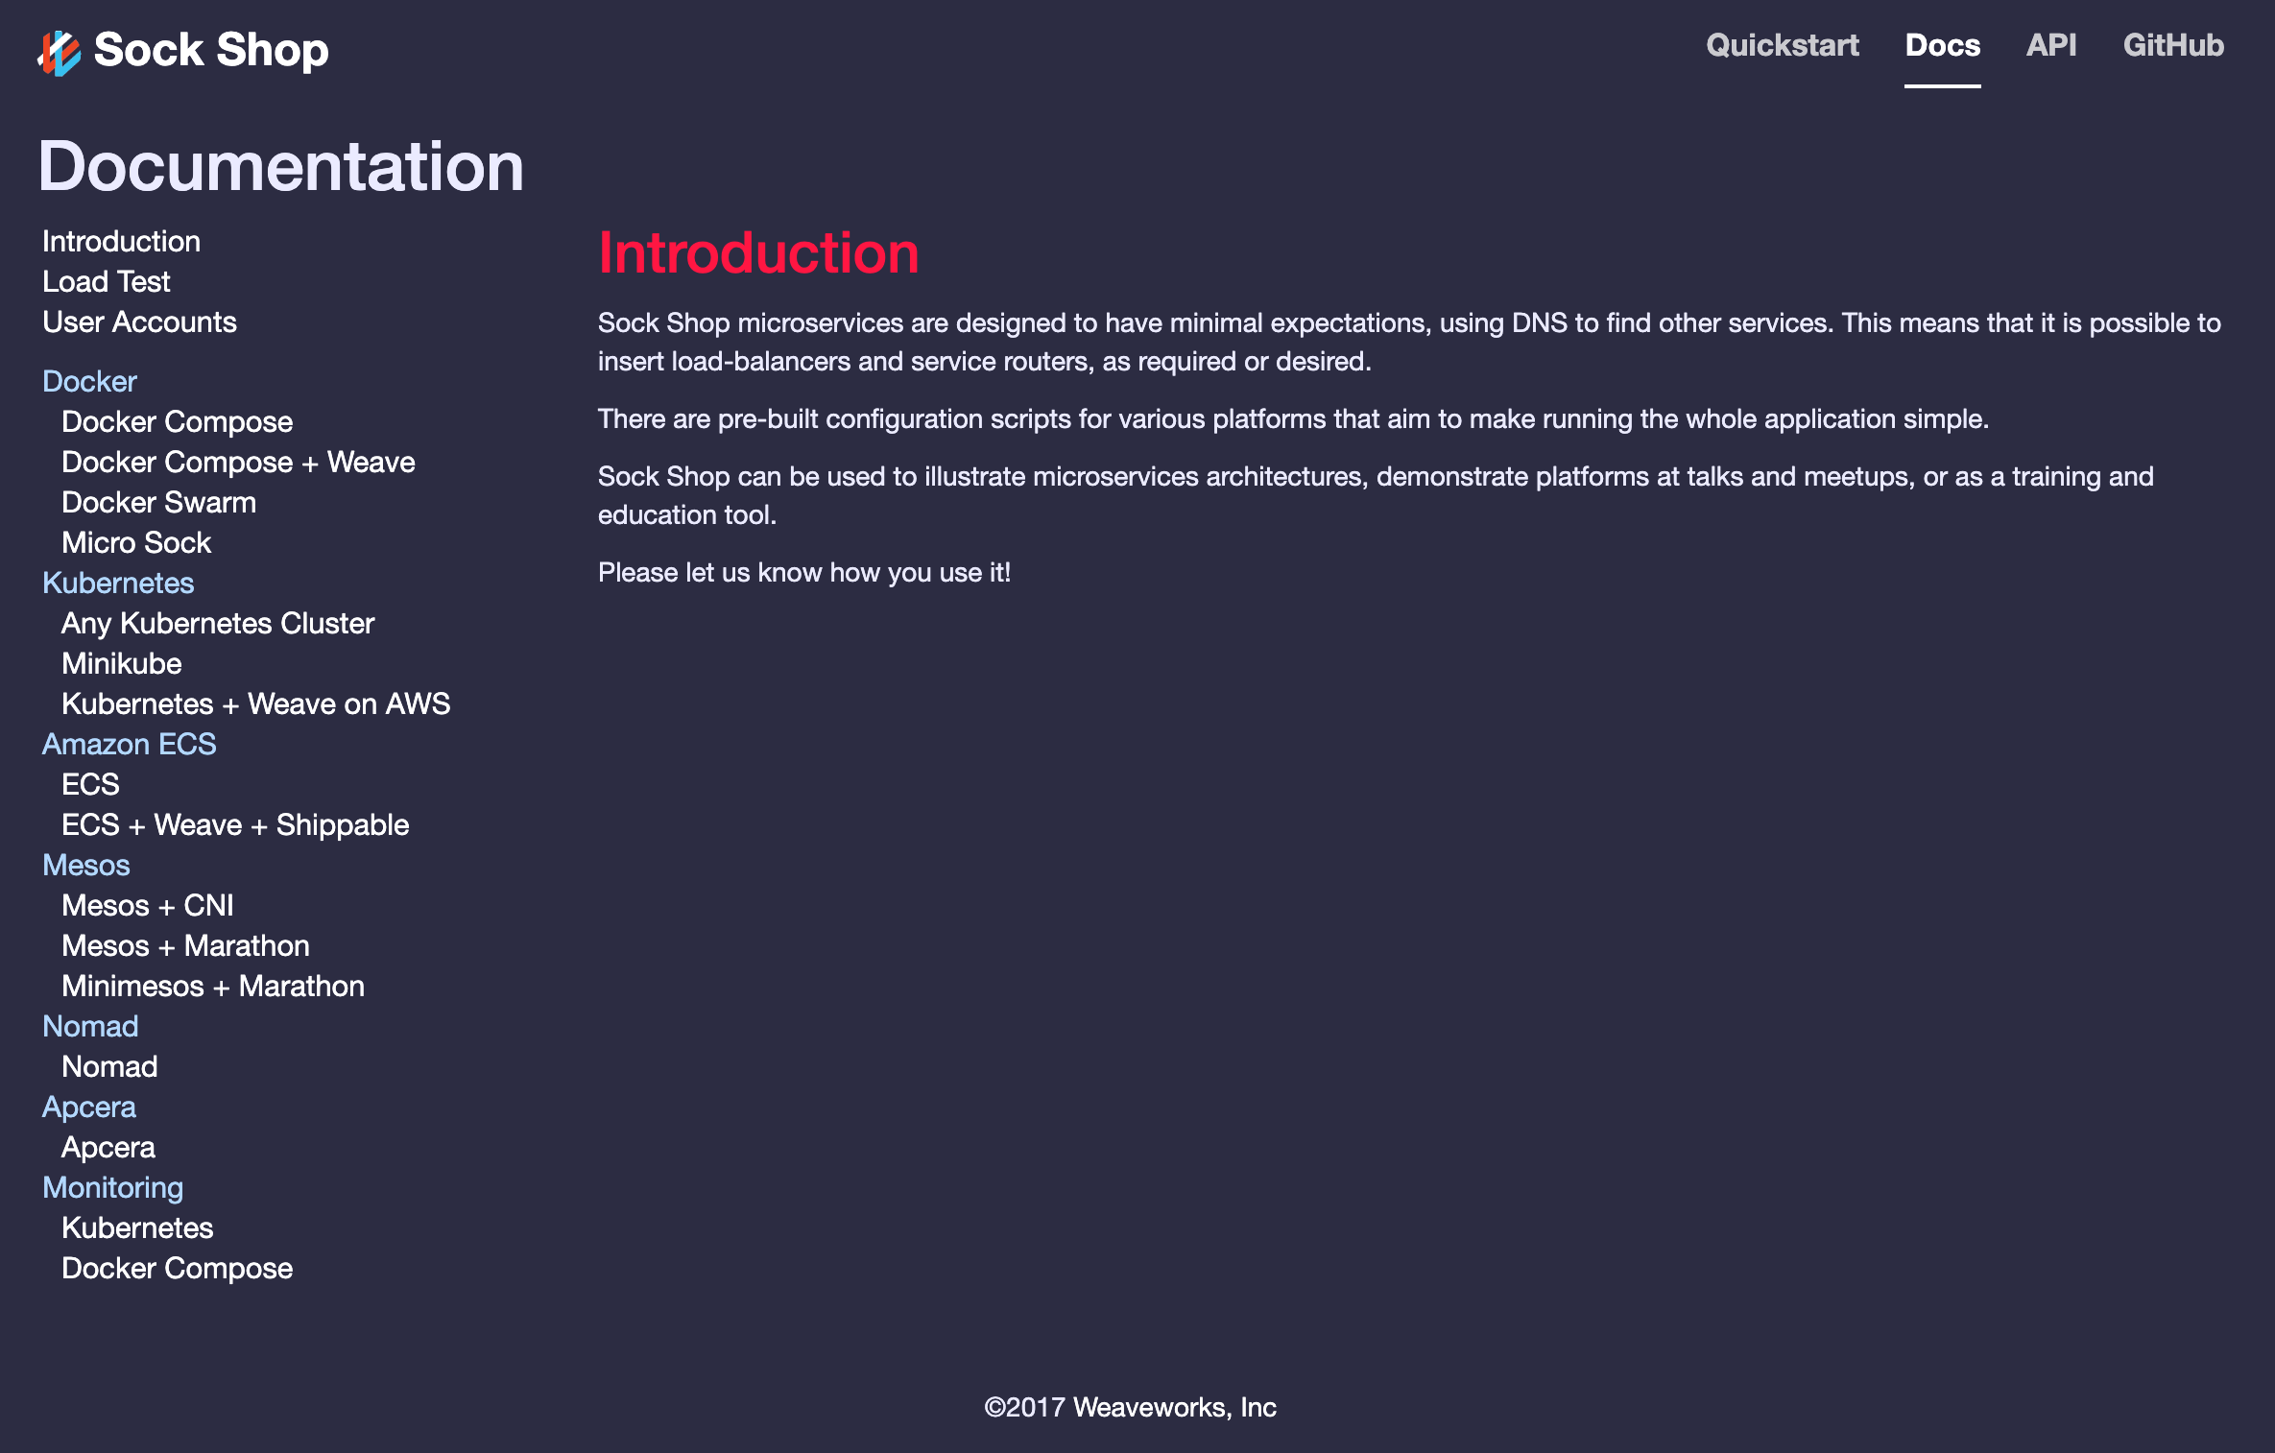
About the Sock Shop Application
Open Source example of an e-commerce website that sells socks.
Developed by WeaveWorks to Demonstrate Microservice Monitoring solutions.
Microservices written in node.js, Java, and Go, including MySQL, Mongo, RabbitMQ
Open instructions for multiple platforms.
Source code and configuration files at https://microservices-demo.github.io

Slide 4
Sock Shop Function Layout

Slide 5
How HashiCorp Solutions Are Used
Terraform - Provisions all infrastructure (compute, VPC, network) to AWS
Nomad - Schedules and manages the Sock Shop microservices.
Consul – Service discovery, storage backend for Vault, and distributed key/value store for Docker overlay network.
Vault - Dynamically provisions AWS credentials to Terraform and provides database passwords to Nomad.

Slide 6
Other Technologies Used
Docker – Hosts most of the microservices containers necessary for the Sock Shop, and provides and overlay network spanning across the hosts.
Java – Application environment for the queue-master
AWS – All nodes execute on Amazon EC2.
Github – Entire demonstration infrastructure stored and version controlled in Github

Slide 7
HashiCorp Utilization Details - Nomad
Deploys and manages applications across machine clusters (virtual, physical, multi-cloud)
Applies the container concept beyond containers – orchestrating Docker containers, Java applications, executables, etc.
Communicates and manages across regions and clouds, expanding scheduling capabilities.
Single binary used on both client and server nodes, making it architecturally much simpler than options like Kubernetes.

Slide 8
Nomad Running Sock Shop

Slide 9
Nomad Concepts – Namespace, Quota
Namespaces
Subdivide a single cluster for multiple teams
Works with ACLs to segment access per Namespace
Association in Job specification
Quota Allocations
Flexible Quota Allocations across entire cluster or per Namespace
Jobs can be pre-empted based on priority and resource allotment
$ nomad namespace apply -description "QA instances of webservers" web-qa
name = "default-quota"
description = "Limit the shared default namespace"
limit {
region = "global"
region_limit {
cpu = 2500
memory = 1000
}
}
$ nomad quota status default-quota
Name = default-quota
Description = Limit the shared default namespace
Limits = 1
Quota Limits
Region CPU Usage Memory Usage
global 500 / 2500 256 / 1000

Slide 10
Demo

Slide 11
Demonstration Takeaways
Nomad is used to manage jobs across multiple technologies (Docker and Java demonstrated here) operating within a cluster
Namespaces and quotas work together to manage available resources per team or group
Planning priorities and preemptions are very useful in heavily loaded clusters or namespaces
Sentinel Policies are critical to secure operations of the cluster

Slide 12
Internal Lessons Learned
Upgrade from Terraform 0.11 to 0.12 isn’t trivial
Command line tool does convert .tf files, but not everything
Nomenclature around string usage left out – case by case basis
Some of our examples with Terraform can be confusing to a ‘newbie’
AMI created through AWS
More focus would enable use of Packer (to-do)
Github process can take some getting used to
Online education (in onboarding) helps
Tools like Github Desktop and Visual Studio Code are beautiful, but it obfuscates the underlying process
Terraform doesn’t always tear down cleanly!
If state file is ‘stuck’ on resources that can’t be removed, have to remove entire workspace
Ranjit’s workspace backup utility is a godsend! (https://whatsaranjit.herokuapp.com/hashicorp/waas)

Slide 13
Next Steps/Evolution
Expand demonstration to utilize resources across multiple cloud services
Add Policy control to demonstrate management of namespace and quotas
Simplify repo to have just what we need, including packer AMI creation.
Develop similar system with Kubernetes to compare differences in complexity

Slide 14
Thank You!

Slide 15
HashiCorp Utilization Details - Terraform
Provisions all infrastructure on AWS - Instances, VPCs, Security Groups, IAM role, etc.
Builds configuration files for applications utilizing dynamic data discovered during deployment (like IP addresses)
Enables centralized configuration of system-wide parameters (nomenclature, security data, images)
Installs and configures applications, databases, etc., including Nomad, Consul, and Docker.
Initializes containers and applications

Slide 16
HashiCorp Utilization Details - Consul
Registration, discovery, and health checking for all services (cart, order, catalog, etc.)
Provides a distributed key/value store for the Docker Overlay network for microservice communications.
Like Nomad, Consul has a single binary used on both client and server nodes, making it architecturally much simpler than options like etcd and ZooKeeper.

Slide 17
HashiCorp Utilization Details - Vault
Vault securely manages secrets in private and public clouds.
It can generate secrets dynamically. This includes AWS keys, database usernames/passwords, SSH passwords, and PKI certs.
Vault acts as an identity broker that lets applications and people authenticate themselves to Vault with many mechanisms so that they can then read and write secrets.
Vault also offers encryption as a service (EaaS).
Maintains encrypted AWS Access Keys, providing to Terraform on demand.

Slide 19
Sock Shop Microservices Deployed by Nomad
front-end
(node.js)
UI
Main Services
External Services
user
(Go)
catalogue
(Go)
cart
(Java)
orders
(Java)
payment
(Go)
shipping
(Java)
Databases
rabbitmq
(Erlang)
user-db
(Mongo)
cataloguedb
(MySQL)
cart-db
(Mongo)
orders-db
(Mongo)
queue master
(Java)
Docker Driver
Java Driver
Notes:
Environment utilizes multiple services on different platforms. One of the key benefits of Nomad is to be able to manage workloads regardless of their application base – microservices, batch, containerized, non-containerized, etc.

Slide 20
Other Technologies Used
Most of the Sock Shop microservices run inside Docker containers after being loaded from Docker images.
But one of them, queue-master, runs as a Java application directly on one of the Nomad instances.
We’re also using an overlay Docker network that spans multiple hosts. As mentioned on the previous slide, Consul is used as a distributed key/value store for this network.
Everything is deployed to Amazon EC2.

Slide 21
Packer
Packer is very flexible and easy to use. It can create identical images for multiple platforms, such as VMware for testing and AWS for production.
In this demo, we use it to build an AMI that includes Nomad, Consul, and Docker with everything provisioned and ready to run

Slide 22
How HashiCorp Runs Microservices in the Cloud
Packer builds AMIs and other VM images.
Terraform provisions these images and other infrastructure to private and public clouds, using “infrastructure as code”. This includes pulling your Terraform code from your VCS system and managing state of the provisioned infrastructure.
Nomad schedules and manages the applications across clusters that span multiple regions and clouds on both Linux and Windows.
Consul lets the microservices discover and talk to each other no matter where they are deployed.
Vault secures and manages your secrets such as passwords and keys.

Slide 23
Terraform
Terraform provisions the machines you need and deploys software to them. It can do this in any cloud, whether private or public.
In this demo, Terraform provisions server and client EC2 instances running Nomad, Consul, and Docker along with a security group that allows all required network communications to occur.
It also builds the Nomad and Consul configuration files from templates after replacing things like IP addresses and the URL of the Vault server from which Nomad retrieves secrets.

Slide 24
Nomad
Nomad deploys and manages applications across clusters of many virtual and/or physical machines.
It can run Docker containers as we have discussed, but can also run other workloads, whether containerized or not, including Java applications.
Nomad does not limit you to a single region or even to a single cloud vendor.
Nomad has a single binary used on both client and server nodes, making it architecturally much simpler than options like Kubernetes.

Slide 25
Consul
Consul provides a distributed key/value store and service registration and discovery along with health checking of nodes and services.
Like Nomad, Consul has a single binary used on both client and server nodes, making it architecturally much simpler than options like etcd and ZooKeeper.

Slide 26
Vault
Vault securely manages secrets in private and public clouds.
It can generate secrets dynamically. This includes AWS keys, database usernames/passwords, SSH passwords, and PKI certs.
Vault acts as an identity broker that lets applications and people authenticate themselves to Vault with many mechanisms so that they can then read and write secrets.
Vault also offers encryption as a service (EaaS).

